Slide 1
Tuna
Mobile Application and Cloud Computing
Sapienza University, Rome
2019-2020
Nicola Di Santo, Matteo Rizza

Slide 2
App Goal
Proof of concept of a basic search engine specific for recipes.

Slide 3
Main Features
Authenticate to use
Search recipes by ingredient
Save locally favorite recipes
Add ingredient you do not have into a shopping list
Find markets near to you

Slide 4
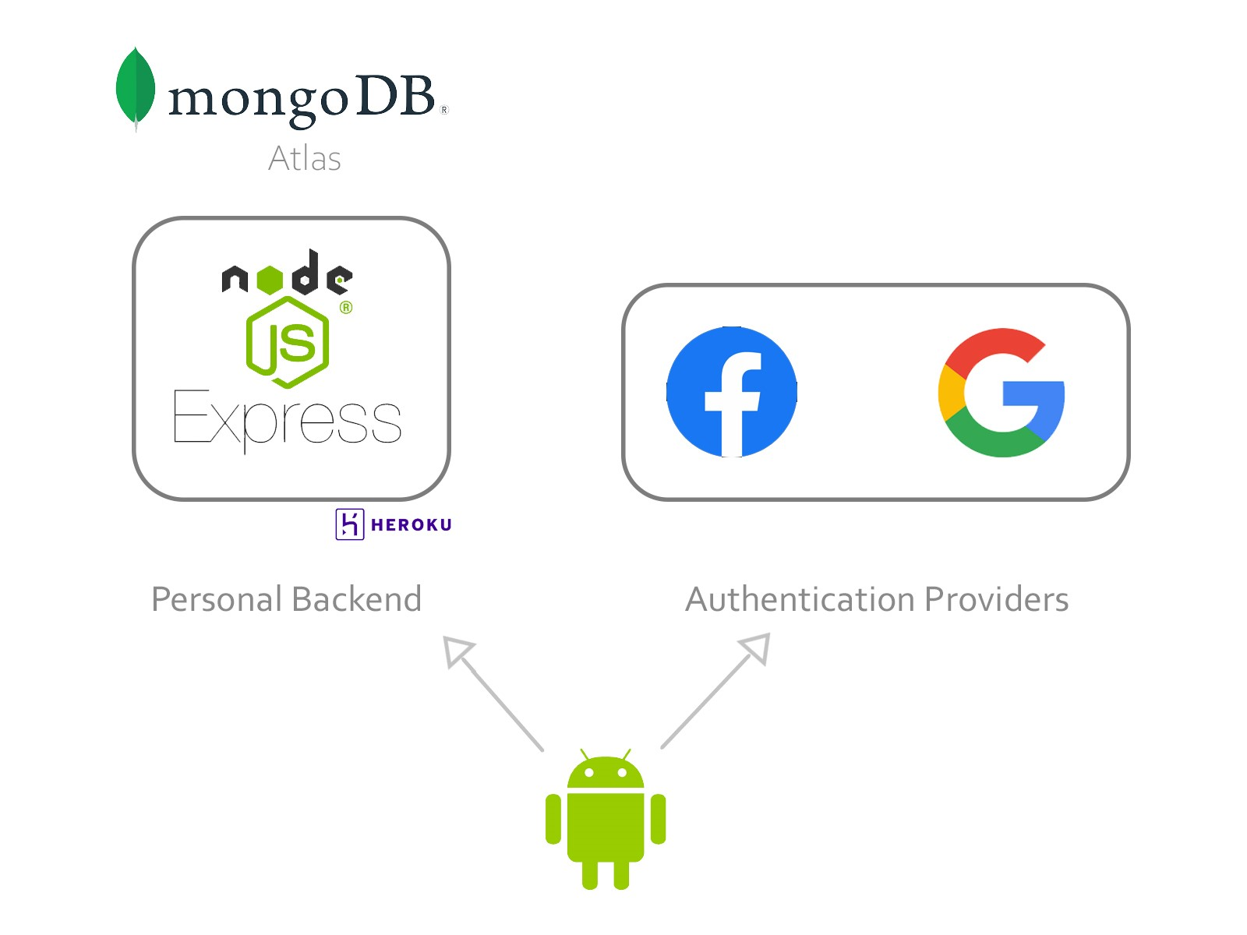
High Level Components

Slide 5
Thank You For The Attention

